Slide 1
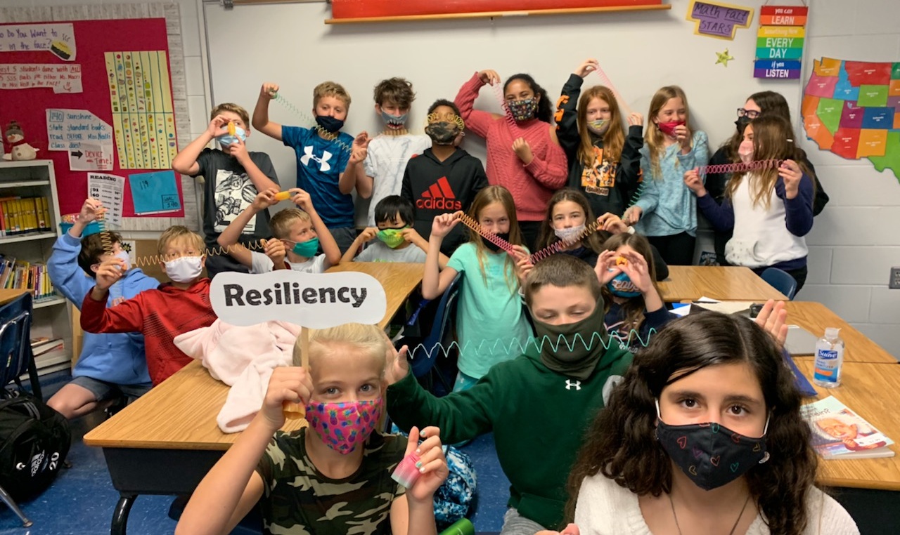
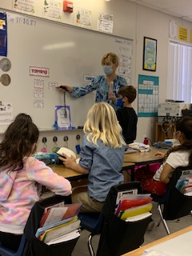
Building Resiliency in Students at Laurel Oak Elementary School
Mrs. Gaillard
School Counselor

Slide 2
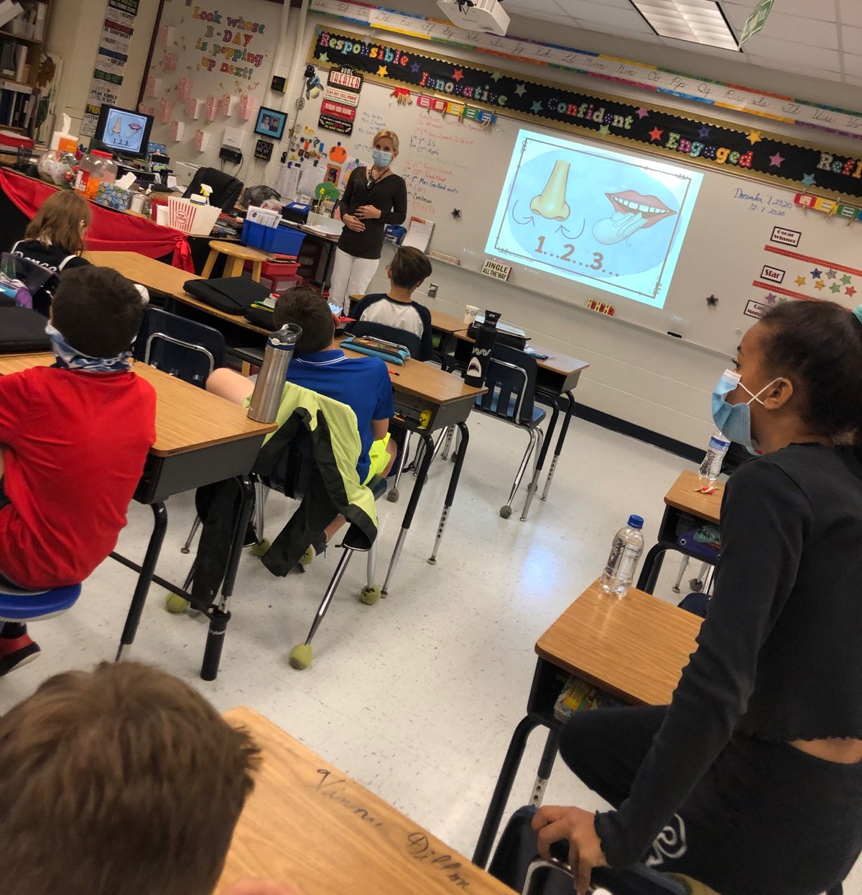
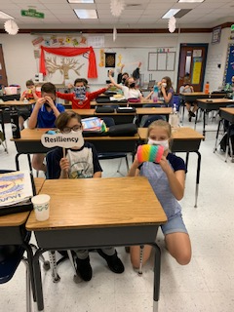
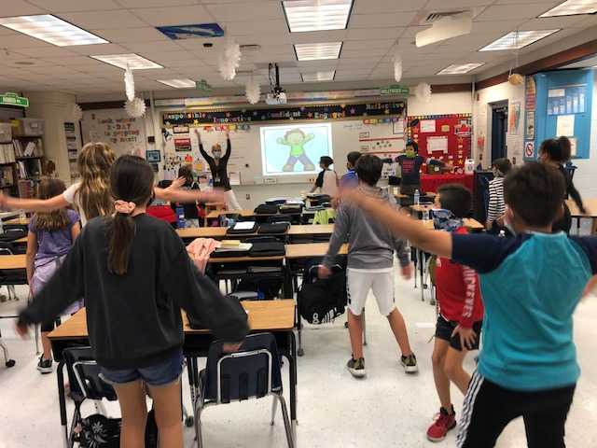
Students learn stress management skills as part of Mrs. Gaillard’s Resiliency Program.

Slide 3
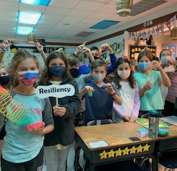
Mrs. Gaillard talking about Resiliency
LOE facebook page:
https://www.facebook.com/ccpsloe/videos/820658638759822/

Slide 4
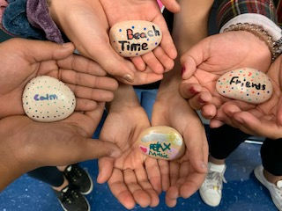
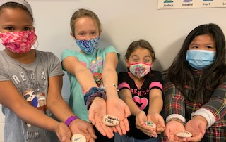
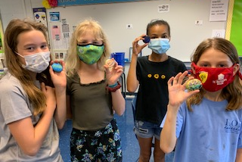
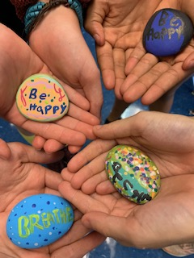
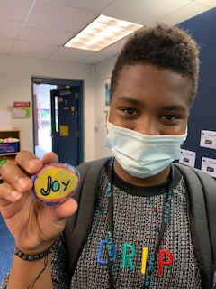
Resiliency Rocks!

Slide 5
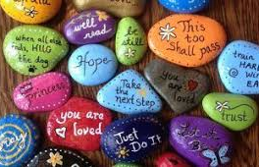
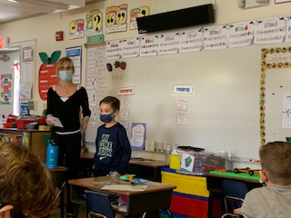
Resiliency Rocks

Slide 6
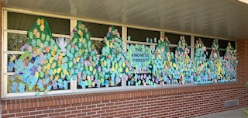
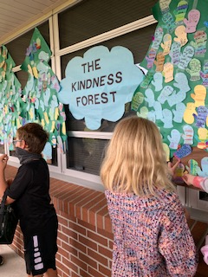
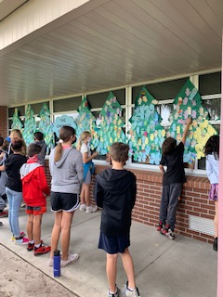
The Kindness Forest
https://youtu.be/ztOqWcpw30k
Please click on the link to play the video!
We show resiliency by showing kindness to ourselves and others!
School wide we read The Mitten Tree by Candace Christiansen.
Every student in our school was given a mitten and wrote an act of kindness they did for someone.
Students taped their mitten to the tree. By the end, we had over 1,000 mittens on the tree.

Slide 7
Mrs. Gaillard explaining resiliency to parents on the Morning News:
https://collierschools.instructuremedia.com/embed/94efcb65-5a1b-4159-a154-a08a35c34ae7

