Slide 1
POW!
This one is tricky, but you will succeed.
Sort all the cards before you proceed.
The definition shows the letter position.
Look to the term to complete this mission.
Now where to put this letter you’ve found?
Look to the pictures, more numbers abound.
The letters together will give you a word.
One letter is extra, it’s presence absurd.
Use this word to open a lock.
Which lock is it? Just pick one, don’t gawk.
FUN FACT! It is Inverse Day! This is an unofficial holiday when words are written in reverse. It is usually observed among teens and rarely lasts an entire day. Once Inverse Day is declared, code words are written right to left rather than left to right.

Slide 2
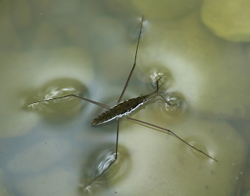
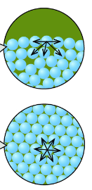
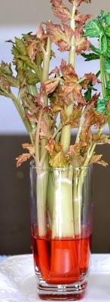

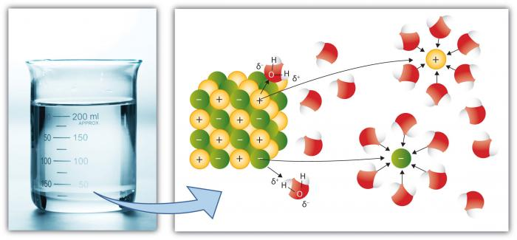


Cohesion | Adhesion | Universal Solvent
Attraction of water molecules to other water molecules; causes surface tension and beading | Water molecules attract other types of molecules. Works with another property of water to create capillary action. | Ability of water to dissolve more substances than any other liquid
2
4
3
7
1
9

Slide 3
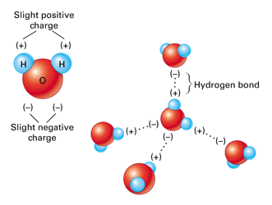
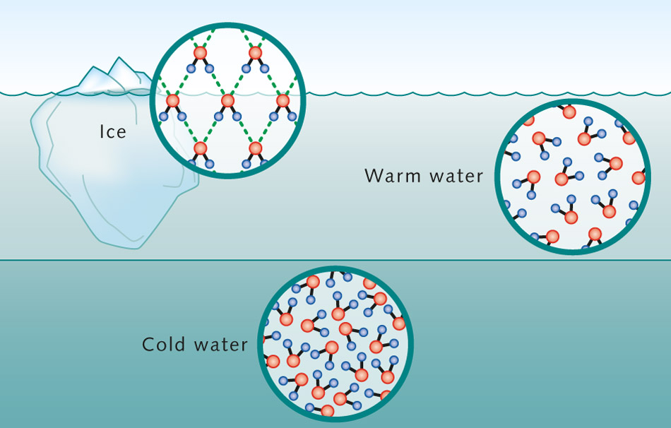
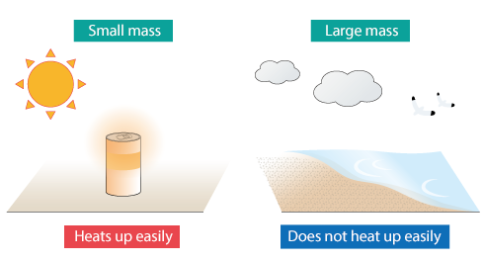
High Heat Capacity | Polarity | Expansion upon Freezing
Ability of water to absorb large amounts of thermal energy with only small changes in temperature. Allows large bodies of water to maintain stable temperatures. | Uneven sharing of electrons within water. Results in a slightly negatively charged oxygen atom and a slightly positively charged hydrogen atoms. Creates distinct poles on the molecule. | Water molecules separate as they freeze, causing ice to float in water
6
5
1
3
5
3

Slide 4
POW!
Teacher Information
Cut up the cards on slides 2 & 3 and place them in an envelope for each team.
Place the student sheet (slide 1) in the envelope.
Students should sort the cards so that the pictures and definitions match the term.
The rhyming clues should alert students to use the number in the definition to match letters in the term as follows:
  High Heat Capacity = 3. The 3rd letter is G.
  Polarity = 5. The 5th letter is R.
  Expansion upon Freezing = 3. The 3rd letter is P.
  Cohesion = 7. The 7th letter is O.
  Adhesion = 1. The 1st letter is A.
  Universal Solvent = 9. The 9th letter is L.
The number in the picture/diagram card gives the position of that letter in the word. The 6th letter (that from High Heat Capacity) is not used as per the clue.
The letters spell out POLAR and is used to unlock one of the 5 letter locks.
The answer, however, is ‘RALOP’ because the small ‘Fun Fact’ at the bottom of the rhyming clues informs students that it is ‘Inverse Day’. The teacher may need to point this out to students if they are struggling to open the lock.

