Slide 1
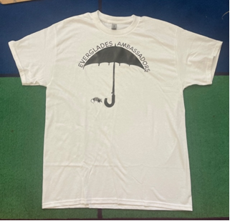
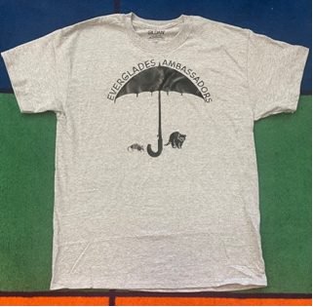
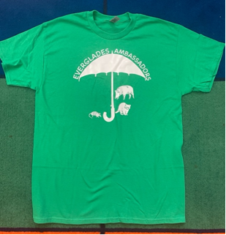
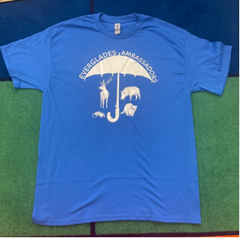
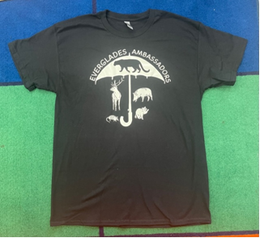
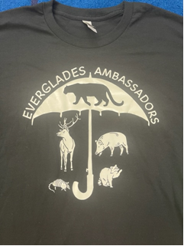
T-shirt #1: all students receive at beginning of year (white, 1 animal)
T-shirt #2: students receive after reaching Q1 literacy/science goals (gray, 2 animals)
T-shirt #3: students receive after reaching Q2 literacy/science goals (green, 3 animals)
T-shirt #4: students receive after reaching Q3 literacy/science goals (blue, 4 animals)
T-shirt #5: students receive after reaching Q4 literacy/science goals (black, 5 animals)
T-shirt #5: up close view (panther represents “umbrella species”)

