Slide 1
Plant Project
Honors Chemistry 2016

Slide 2
What do we do?
Design, plan and execute project
1. choose a plant that is growable in classroom conditions.
We will put lamps on timers to be on certain hours of the day. (Depending on the plant requirements, the 2 lamps may be on different timers).

Slide 3
Why?
For what substance(s) will you be testing the plant?
Sugars, oils, fragrance, dyes, fibers, water, chlorophyll, etc.

Slide 4
HOW?
3. RESEARCH & EXPERIMENT
What ratio of fertilizers are best for your plant? (nitrogen, phosphorus, potassium)
How many daylight hours are best?
How much moisture?
How do I test for my substance?

Slide 5
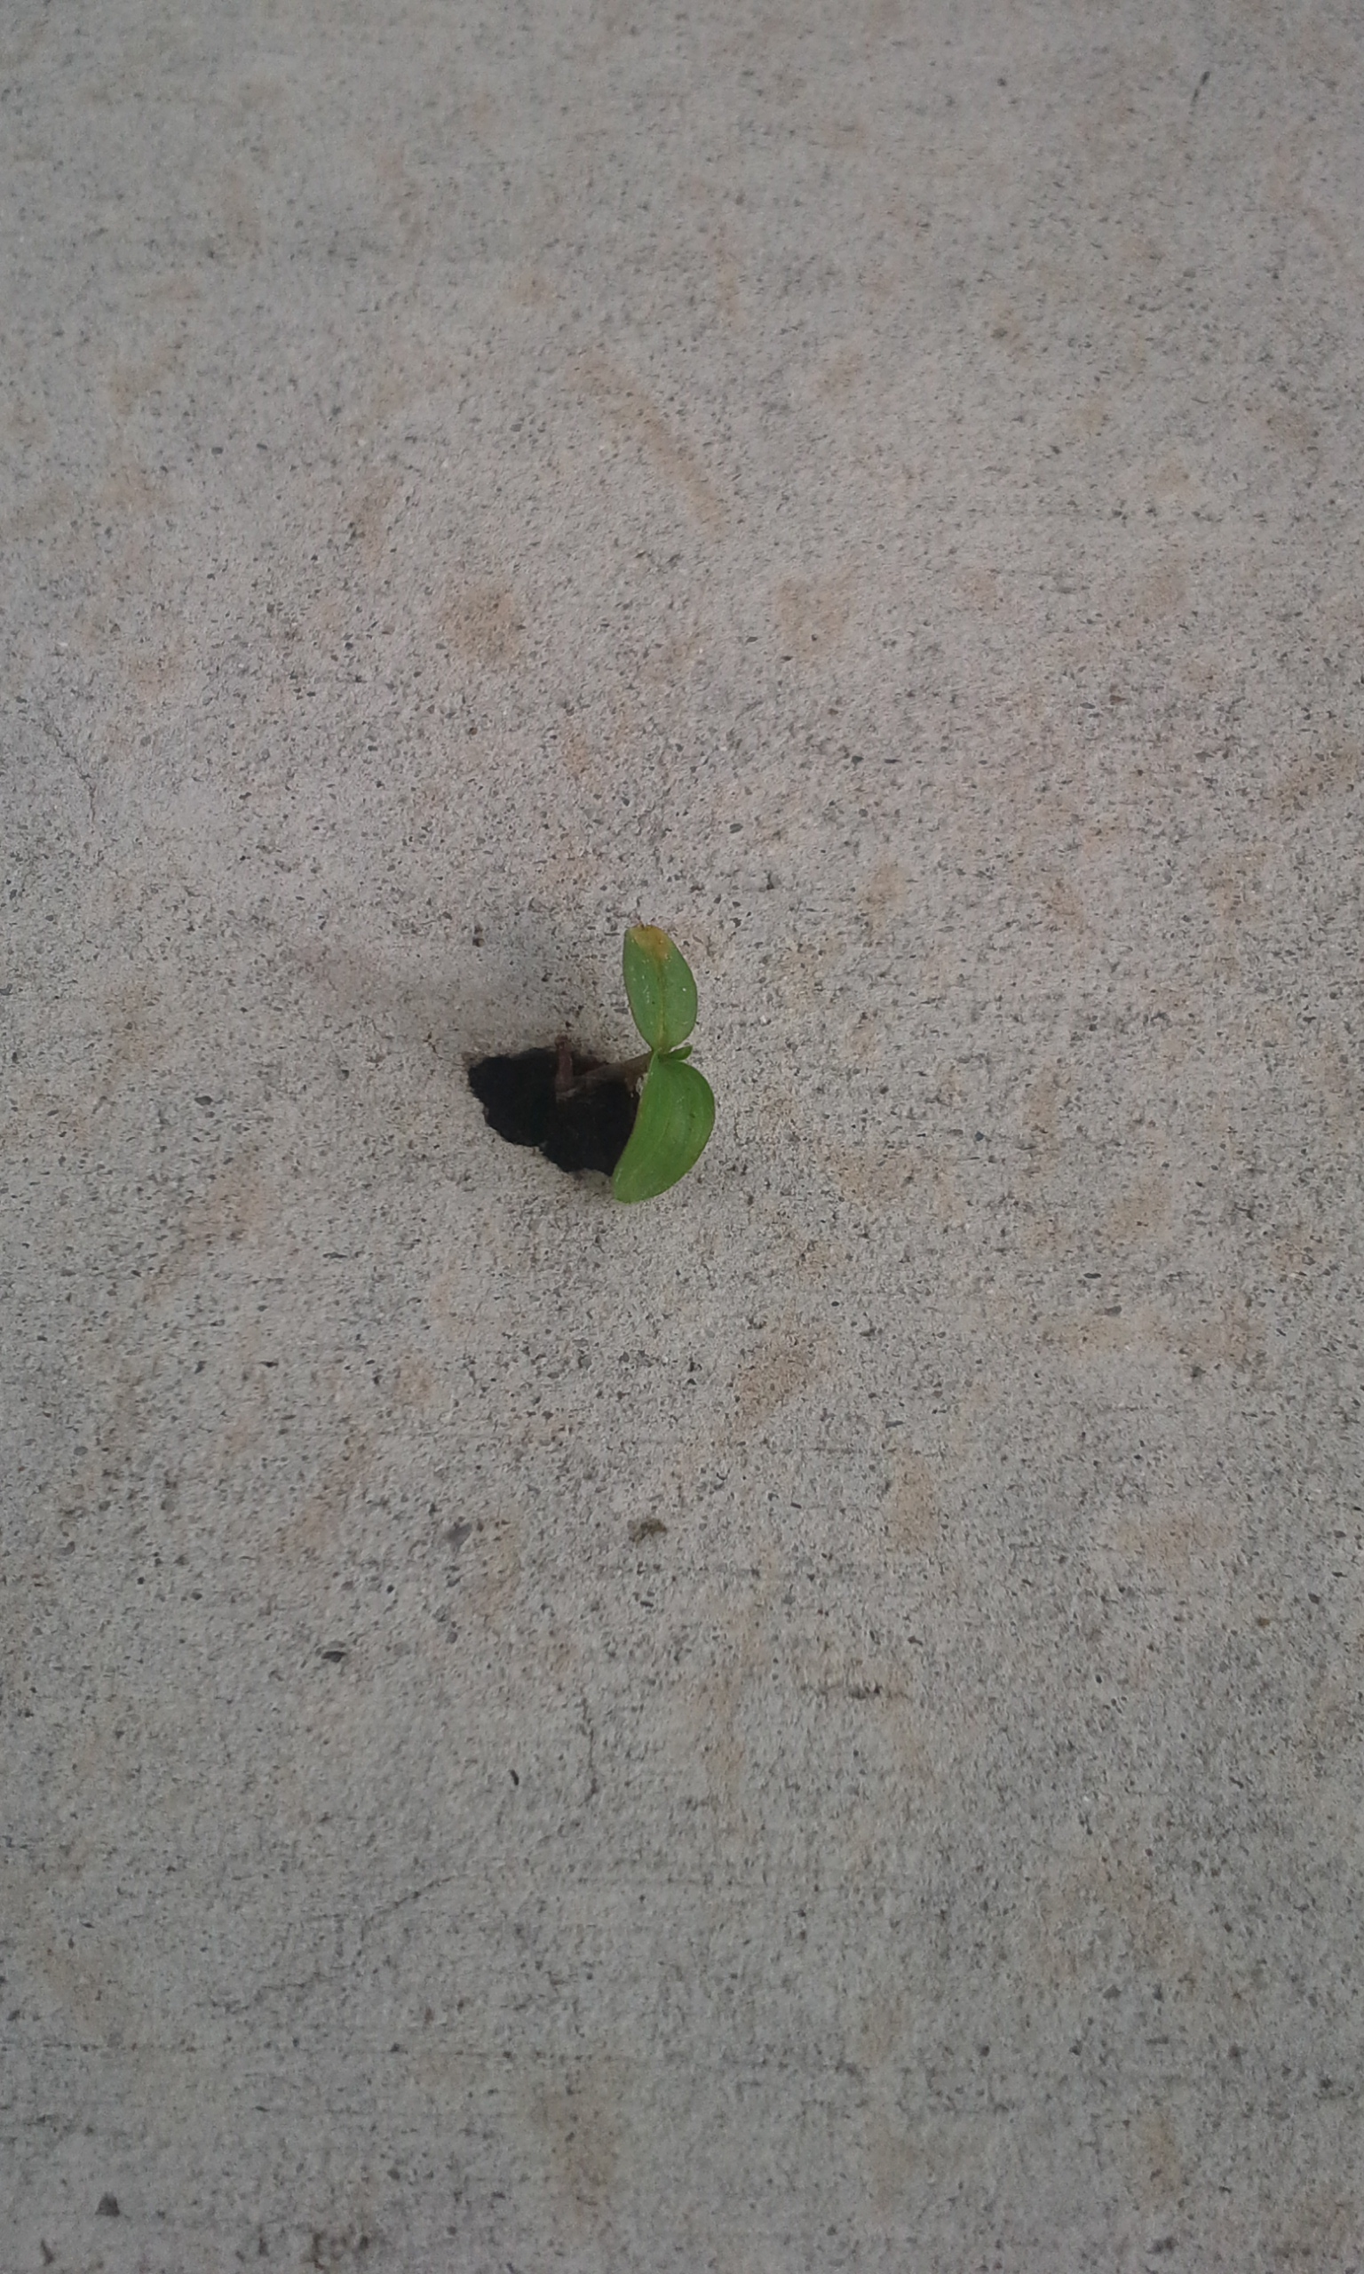
Testing
4. mature enough plant for testing,
Plan and execute your test method.

Slide 6
Analysis & Conclusion
5. Present your findings in a clear, detailed report. - Be sure to include the CHEMISTRY involved.
- Include pictures
- What did you LEARN?
- What unanswered questions are there?
- What might you do differently or for further research?

Slide 7
What do I record?
Pictures!!
Research information:
How many daylight hours?
How much moisture?
Soil pH
Fertilizers
Test method
Successes and failures

