Slide 1
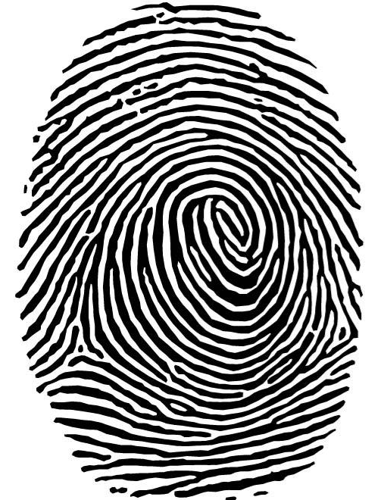
Fingerprint Facts
No two people share the same fingerprints.
Even identical twins, who share the same DNA, have different fingerprints.
Fingerprints remain unchanged throughout one’s lifetime, unless damaged by scarring or disease.
Fingerprints are formed in the womb.

Slide 2
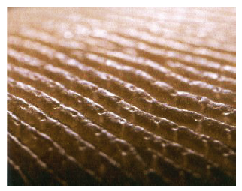
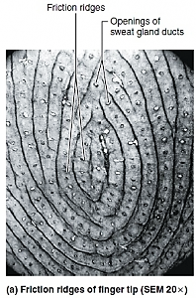
Friction Ridges
Fingerprints are unique patterns, made by friction ridges which appear on the pads of the fingers and thumbs.
Fingerprint impressions occur when oils and saline secreted through the ducts or pores of the fingertips come into contact with a surface.

Slide 3
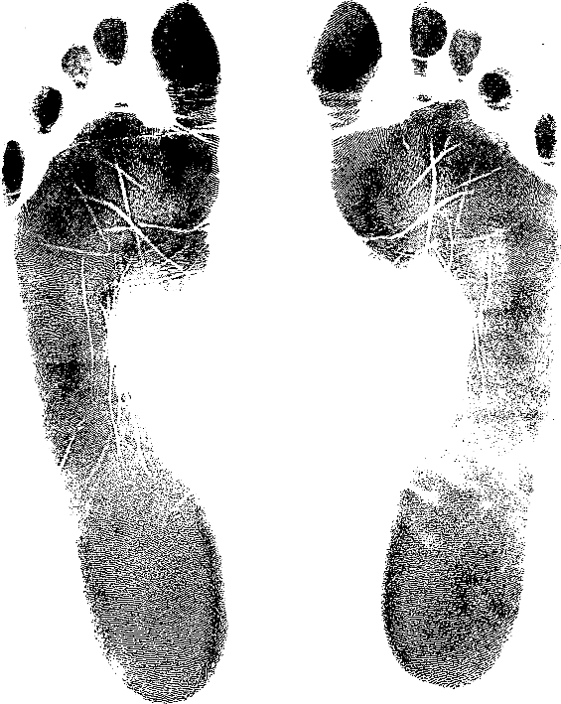
Fingerprint Impressions
A fingerprint is an impression made on a surface by a person's fingertip.
Fingerprint impressions can be made by a variety of substances, including blood, dirt, grease, or any other foreign matter present on the ridges of the skin.
Prints from palms, feet and toes are also unique; however, these are used less often for identification.

Slide 4
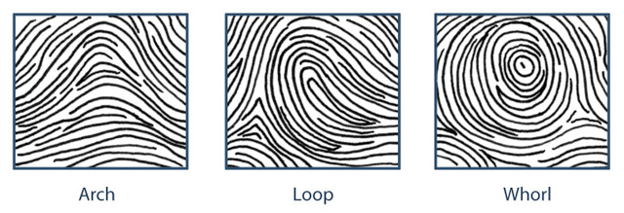
Types of fingerprint patterns
Friction ridge patterns are grouped into three
distinct types: arches, loops, and whorls.

Slide 5
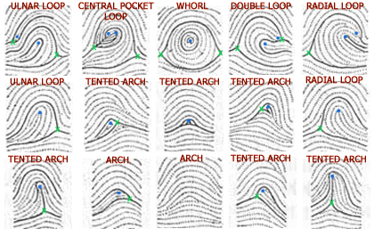
Fingerprint Frequency
Loops ~ 60% of population
Whorls ~ 35% of population
Arches ~ 5% of population

Slide 6
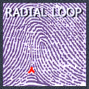
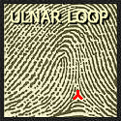
Loops
In a Loop pattern, the ridges will flow in one side, loop around and exit the pattern on the same side as it entered.
A loop pattern has only one delta.
There are two types of loop patterns:
1. Ulnar loop
2. Radial loop

Slide 7
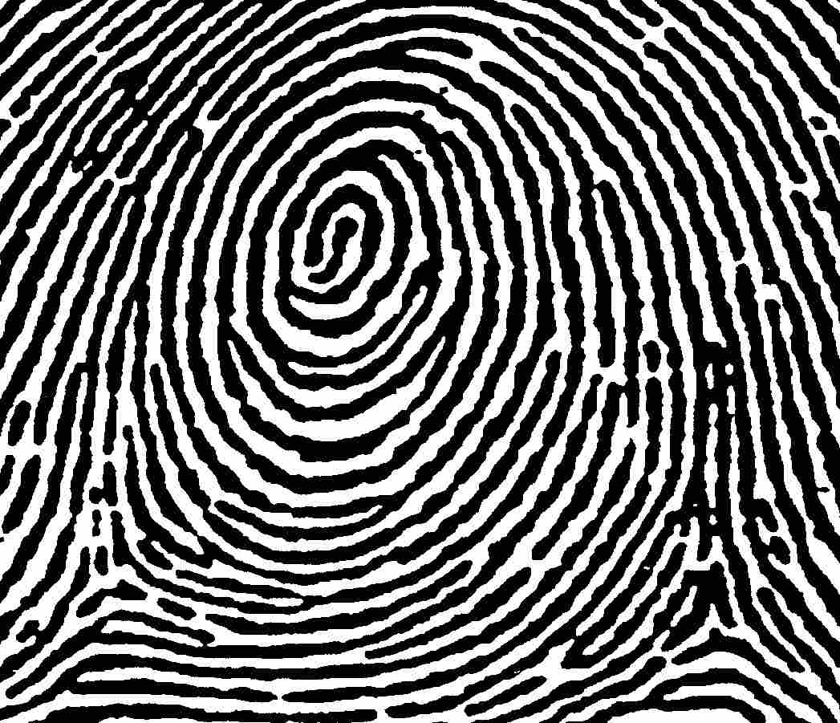
Whorls
Plain Whorl
A whorl pattern consists of a series of almost concentric circles.
A whorl pattern has two deltas.
There are four types of whorl patterns:
1. Plain whorl
2. Central Pocket Loop whorl
3. Double Loop whorl
4. Accidental whorl

Slide 8
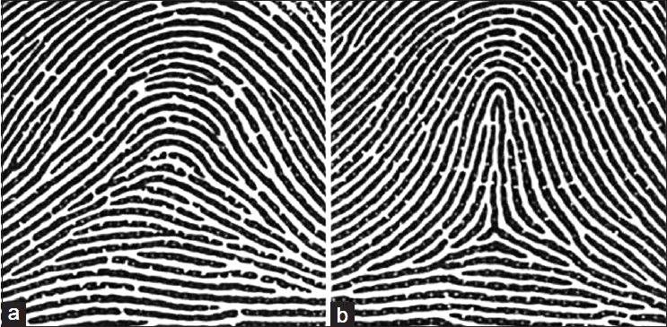
ARches
Plain Arch Tented Arch
In an arch pattern, ridges flow in one side and flow out the opposite side.
There are no deltas in an arch pattern.
There are two types of arch patterns:
1. Plain arch,
2. Tented arch

Slide 9

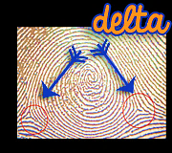
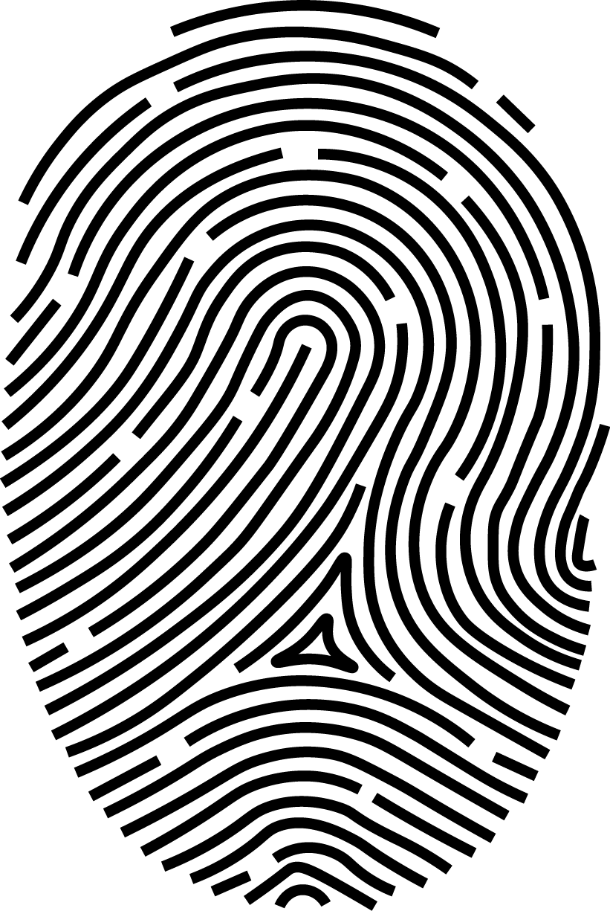
Deltas in Fingerprints

Slide 10
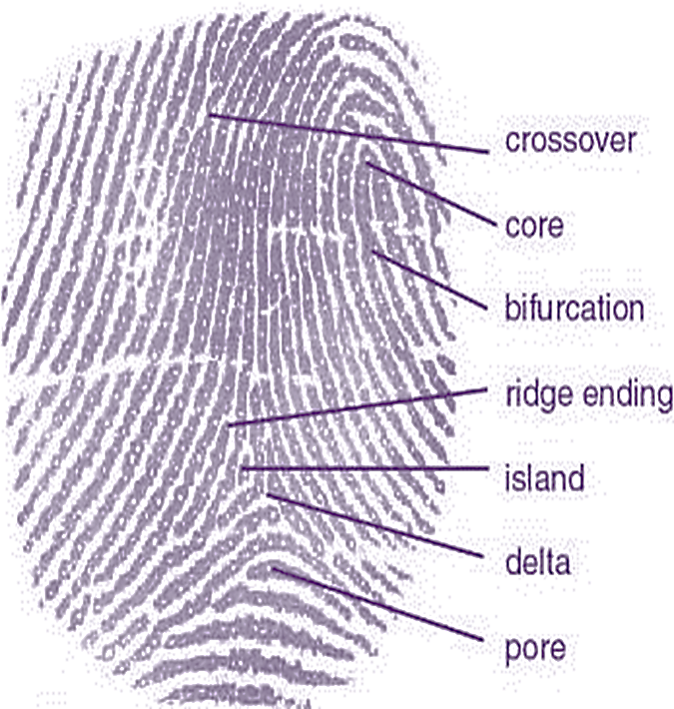
Ridge Characteristics: Minutiae
Each fingerprint contains minutiae or ridge characteristics.
Fingerprints are identified by examining and comparing the ridge characteristics of two different fingerprint impressions to determine if these characteristics occupy the same relative area and position.

Slide 11
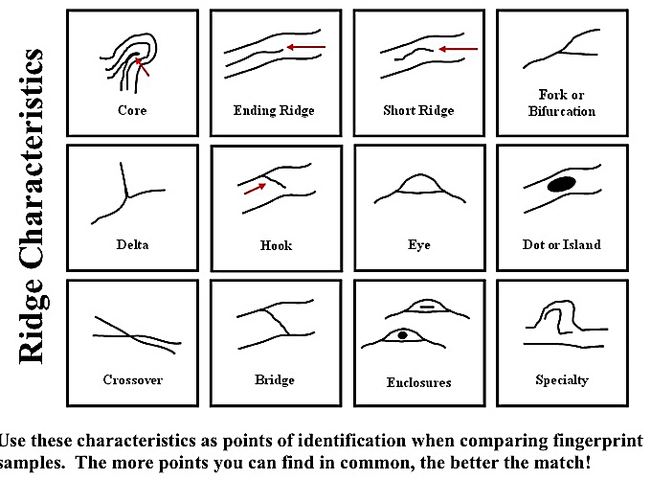
Minutiae Details in Fingerprints

