Slide 1
Processing the crime
By: Pablo m. , Ariel L.

Slide 2
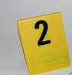
Assessing the crime scene
Evaluate measure’s such as perimeter security , and access control to which the preliminary documentation of the crime scene has been made.
Conduct a crime scene walk-through to determine any possible risks to safety.
Determine the need for a search warrant before collection of evidence.
Create a plan to protect the evidence (from destroying or contaminating evidence).

Slide 3
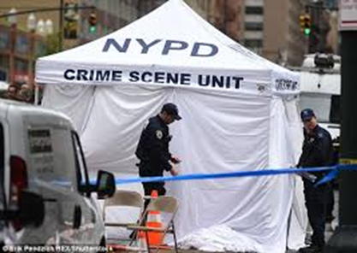
Assessing the crime
Identify and need safety garments to process the crime scene
Identify separate area for personnel or equipment
Plan out a method to process the scene and a route to destroy the lest amount of evidence

Slide 4
Conducting the walk-through
Conducting a scene walk through provides investigators in charge with an overview of the entire scene.
Provides first opportunity to identify important or fragile evidence.
Determine initial investigative procedures , providing for a systematic examination and documentation of the scene.

Slide 5
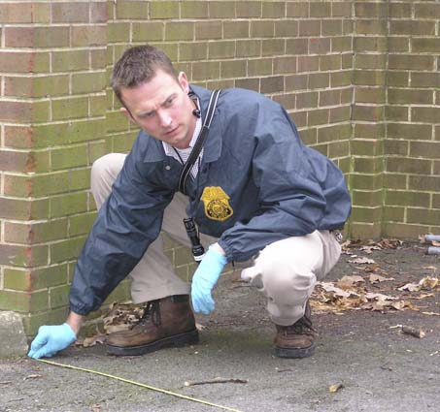
Beginning the search
Surveying the crime scene
Documenting the crime scene through sketches & photographs
Recording all physical evidence
Searching for fingerprints
The search of the crime consists of several distinct phases:

Slide 6
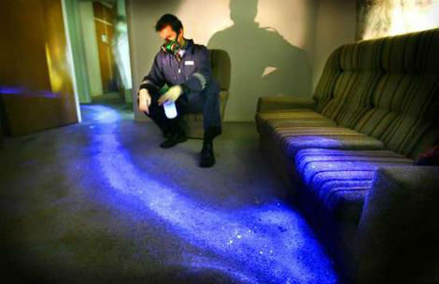
Beginning the search
There are a lot of searches conducted, there are:
Search patterns
Indoor crime scene search
Outdoor crime scene search
Nighttime crime scene search
Vehicle search

Slide 7
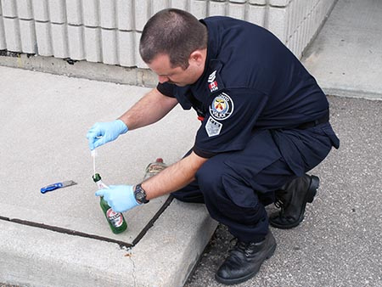
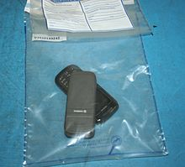
Collecting evidence
There is a tendency on the part of many investigations to rush evidence collection and focus attention on the obvious.
As important as it is to collect evidence it is as equally important to have the proper method to collect the evidence without destroying as little as possible.
This Photo by Unknown Author is licensed under CC BY-SA

Slide 8
References
www.crime-scene-investigator.net/possiblehomicide.html

